Slide 1

Add a cognitive side to your apps with Microsoft Cognitive Services
Ashish Sahu
ashish.sahu@Microsoft.com

Slide 2

Microsoft Cognitive Services
microsoft.com/cognitive
Vision
Speech
Language
Knowledge
Search
Computer Vision
Custom Recognition
Spell Check
Academic Knowledge
Bing Web Search
Emotion
Bing Speech
Entity Linking
Bing Image Search
Language Understanding Intelligent Service
Face
Speaker Recognition
Knowledge Exploration
Bing Video Search
Video
RT Translation
Text Analytics
Recommendations
Bing News Search
Web Language Model
Bing Autosuggest

Slide 3









Why Microsoft Cognitive Services?
Easy
Flexible
Tested
Roll your own with REST APIs
Simple to add: just a few lines of code required
Integrate into the language and platform of your choice
Breadth of offerings helps you find the right API for your app
Built by experts in their field from Microsoft Research, Bing, and Azure Machine Learning
Quality documentation, sample code, and community support
GET A KEY
BUILD

Slide 4
Vision
From faces to feelings, allow your apps to understand images and video
Computer Vision | Emotion | Face | Video

Slide 5
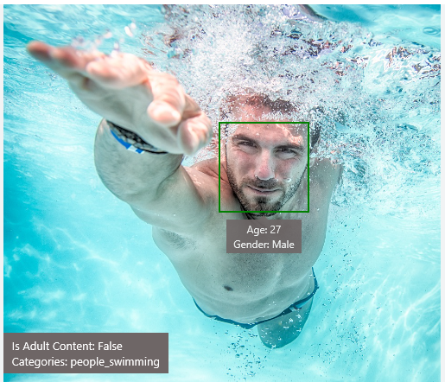
Analyze image
Type of image
Image Format jpeg
Image Dimensions 1500 x 1155
Black & White Image False
Content of image
Description “a man swimming in a pool of water”
Categories [{ “name”: “people_swimming”, “score”: 0.099609375 }]
Adult Content False
Adult Score 0.18533889949321747
Faces [{ “age”: 27, “gender”: “Male”, “faceRectangle”: {“left”: 472, “top”: 258, “width”: 199, “height”: 199}}]
Image colors
Dominant Color Background White
Dominant Color Foreground Grey
Dominant Colors White
Accent Color

Slide 6

OCR
Good at
JSON:
{
"language": "en",
"orientation": "Up",
"regions": [
{
"boundingBox": "41,77,918,440",
"lines": [
{
"boundingBox": "41,77,723,89",
"words": [
{
"boundingBox": "41,102,225,64",
"text": "LIFE"
},
{
"boundingBox": "356,89,94,62",
"text": "IS"
},
{
"boundingBox": "539,77,225,64",
"text": "LIKE"
}
. . .
Scanned documents
Photos with text
Fine grained location information
LIFE IS LIKE
RIDING A BICYCLE
TO KEEP YOUR BALANCE
YOU MUST KEEP MOVING
Need to improve
Vehicle license plate
Hand-written text
Characters with large sizes

Slide 7
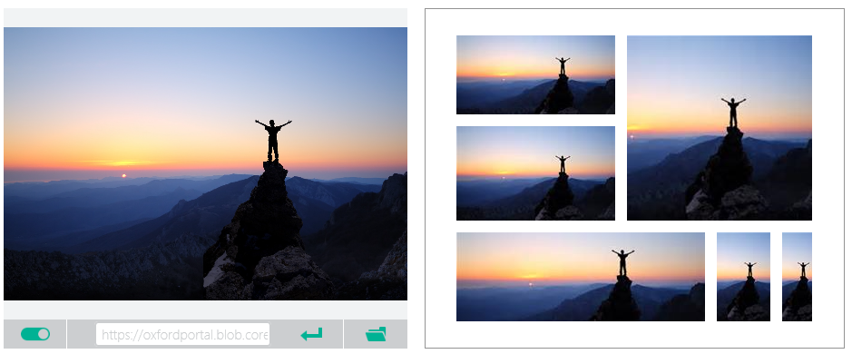
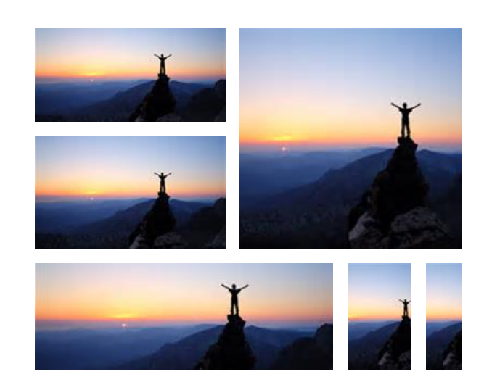


Smart thumbnail
Smart cropping on
Smart cropping off

Slide 8
Vision Demo
From faces to feelings, allow your apps to understand images and video
Computer Vision | Emotion | Face | Video
https://www.microsoft.com/cognitive-services/en-us/computer-vision-api

Slide 9

Recognize emotions Detect emotions based on facial expressions in photos and videos
Emotion APIs

Slide 10
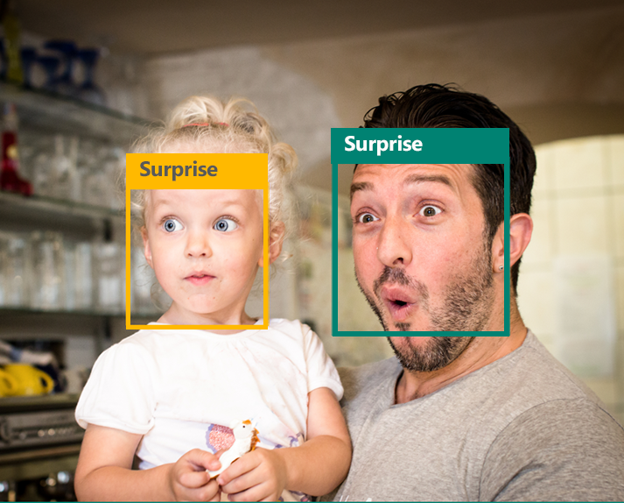
Emotion APIs
Face detection
"faceRectangle": {"width": 193, "height": 193, "left": 326, "top": 204} …
Emotion scores
“scores": { "anger": 5.182241e-8,
"contempt": 0.0000242813,
"disgust": 5.621025e-7,
"fear": 0.00115027453,
"happiness": 1.06114619e-8,
"neutral": 0.003540177,
"sadness": 9.30888746e-7,
"surprise": 0.9952837}

Slide 11

Face APIs
Face detection Detect faces and their attributes within an image
Face verification Check if two faces belong to the same person
Similar face searching Find similar faces within a set of images
Face grouping Organize many faces into groups
Face identification Search which person a face belongs to

Slide 12




Face APIs
Detection
"faceRectangle": {"width": 193, "height": 193, "left": 326, "top": 204}
…
Feature attributes
"attributes": { "age": 42, "gender": "male",
"headPose": { "roll": "8.2", "yaw": "-37.8", "pitch": "0.0" }}
Grouping
Identification
Jasper Williams

Slide 13
Vision Demo
From faces to feelings, allow your apps to understand images and video
Computer Vision | Emotion | Face | Video
https://www.microsoft.com/cognitive-services/en-us/emotion-api

Slide 14


Video APIs
Stabilization Smooth and stabilize shaky video
Face detection and tracking Detect and track faces in videos
Motion detection Detect when motion occurs

Slide 15
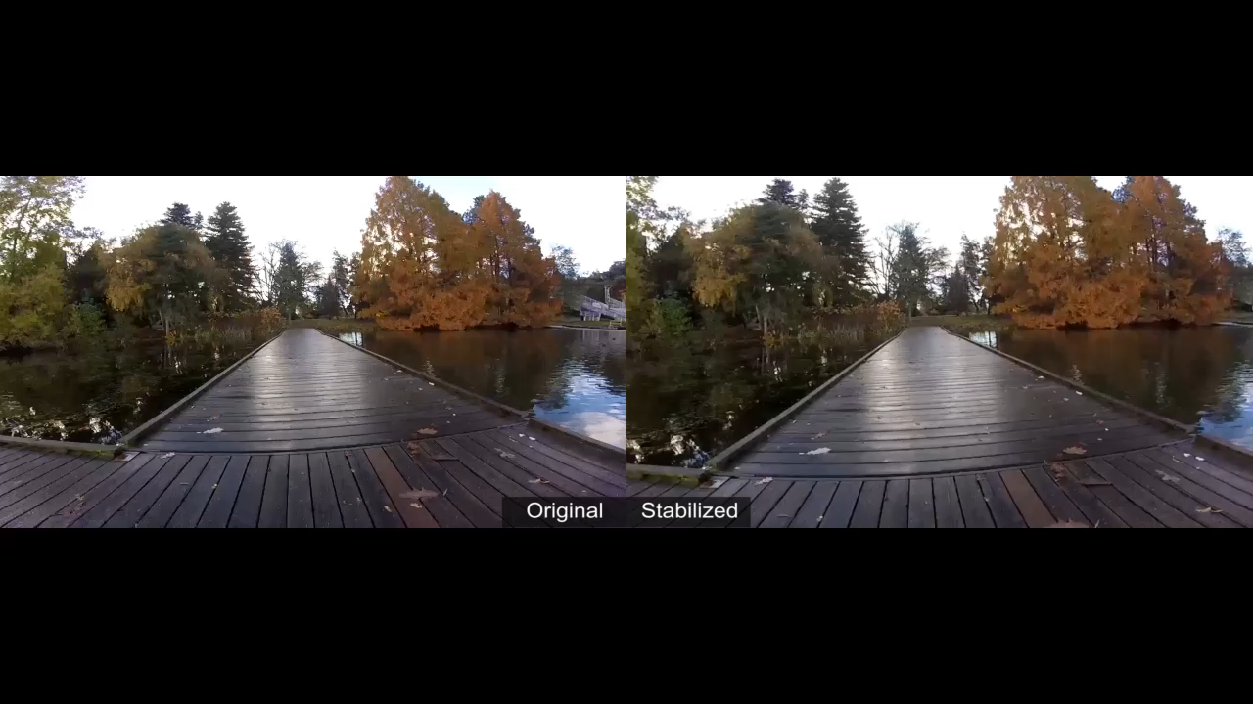
Stabilization
The Stabilization API provides automatic video stabilization and smoothing for shaky videos
This API uses many of the same technologies found in Microsoft Hyperlapse
Best For: Small camera motions, with or without rolling shutter effects (e.g., holding a static camera, walking with a slow speed)

Slide 16
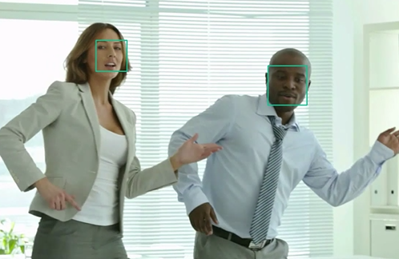
Face detection and tracking
High precision face location detection and tracking
Can detect up to 64 human faces in a video (no smaller than 24x24 pixels)
Detected and tracked faces are returned with coordinates and a Face ID to track throughout the video
Time (sec) | Face ID | x, y | Width, height
0 | 0 | 0.59, 0.23 | 0.09, 0.16
0 | 1 | 0.38, 0.15 | 0.07, 0.12
1 | 0 | 0.54, 0.25 | 0.09, 0.15
1 | 1 | 0.23, 0.18 | 0.07, 0.12

Slide 17
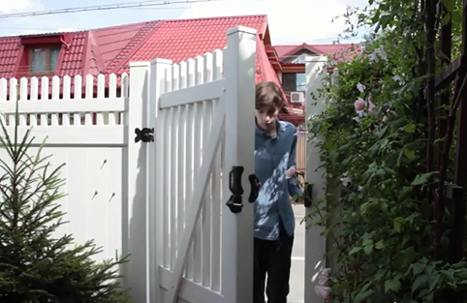
Motion detection
Indicates when motion occurs against a fixed background (e.g., surveillance video)
Trained to reduce false alarms, such as lighting and shadow changes
Current limitations:
No support for night-vision videos
Semi-transparent and small objects are not detected well
Start time | End time | In region
1.9 | 3.6 | 0
5.2 | 15.1 | 0

Slide 18
Speech
Hear and speak to your users by filtering noise, identifying speakers, and understanding intent
Custom Recognition | Speaker Recognition | Speech

Slide 19

Speech APIs
Voice recognition (speech to text) Converts spoken audio to text
Voice output (text to speech) Synthesize audio from text
Speech intent recognition Convert spoken audio to intent

Slide 20
Voice recognition
Short form
Long form
Duration of Audio | < 15 seconds | < 2 minutes
Final Result | n-best choice | Best choice, delivered at sentence pauses
450 6th St. San Francisco
********* Final N-BEST Results *********
[0] Confidence=Normal Text="450 six St San Francisco."
[1] Confidence=Normal Text="For 50 six St San Francisco."
[2] Confidence=Normal Text="456th St San Francisco."
[3] Confidence=Normal Text="450 six St in San Francisco."
[4] Confidence=Normal Text="456 St San Francisco."

Slide 21
Voice recognition
REST API
Client library
SUPPORTED PLATFORMS
Any
Windows, Android, iOS
Real Time Streaming
No
Yes
MIC SUPPORT
No
Yes
SILENCE DETECTION ON MIC
No
Yes
LENGTH OF UTTERANCE
Short
Short and long
NUMBER OF RESPONSES
n-best response back
Multiple partial results, n-best (short), and multiple phrases (long)
Supports 7 languages: en-US, en-GB, zh-CN, it-IT, fr-FR, es-ES, de-DE
Same technology that supports Microsoft offerings of Xbox, Windows, and Cortana

Slide 22
Voice output
Synthesize audio from text via POST request
Maximum audio return of 15 seconds
17 languages supported
<speak version="1.0" xmlns="http://www.w3.org/2001/10/synthesis" xmlns:mstts="http://www.w3.org/2001/mstts" xml:lang="en-US">
<voice name="Microsoft Server Speech Text to Speech Voice (en-US, ZiraRUS)">
Synthesize audio from text, to speak to your users.
</voice></speak>
Synthesize audio from text, to speak to your users

Slide 23
Speech Demo
Hear and speak to your users by filtering noise, identifying speakers, and understanding intent
Custom Recognition | Speaker Recognition | Speech
https://www.microsoft.com/cognitive-services/en-us/speech-api

Slide 24
Speaker recognition API
“”
Speaker verification Check if two voices are the same
Speaker identification Identify who is speaking

Slide 25
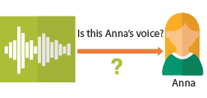
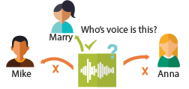
Speaker recognition APIs
“”
Enrollment
Create a unique voiceprint for a profile
Is this Anna’s voice?
Recognition
After enrolling one or more voices, identify who is speaking from an audio clip
Anna
Verification
Who’s voice is this?
Confirm if a voice belongs to a previously enrolled profile
Marry
Mike
Anna

Slide 26
Speech Demo
Hear and speak to your users by filtering noise, identifying speakers, and understanding intent
Custom Recognition | Speaker Recognition | Speech
https://www.microsoft.com/cognitive-services/en-us/speaker-recognition-api

Slide 27
Build Your Application

Slide 28
Azure Commerce Channels Summary for India DC deployment
Enterprise Agreement
Available since Sep 27, 2015
Volume Licensing contract thru LSP
Web Direct
Available - 15th Sept 2016
Open
Available - 15th Sept 2016
CSP
Available - 15th Sept 2016
Allows flexible contracting for complex deals
- Additional promos available on Monitory Commitment
- Option to lock prices for 3 Years
Online subscription using credit card
Start your cloud journey immediately with minimum online subscription
- Transparent Online Pricing
Coupon purchase from partner with/without Credit Card option
Transparent Online pricing
Through Cloud Solution Provider Partner
Additional services can be bundled by CSP
No Credit Card required, invoicing option available
Convenience of offline purchase thru partner

